Slide 1

Pradeeban Kathiravelu, Ph.D. Assistant Professor of Computer Science, Department of Computer Science and Engineering, University of Alaska Anchorage. June 4th, 2025.
Text-Based Coding: Python
https://tinyurl.com/sea2025python

Slide 2
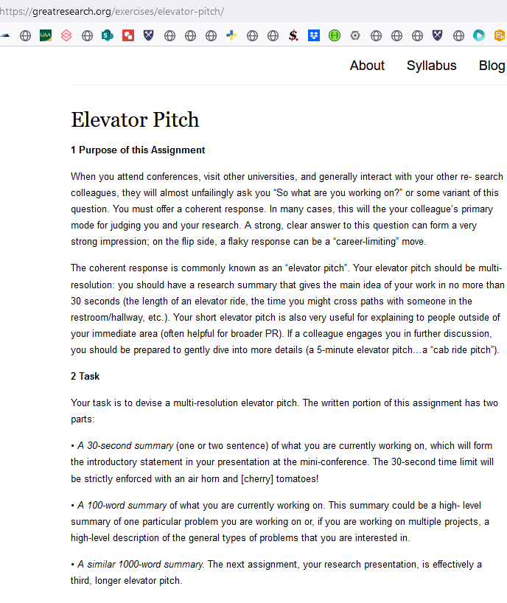
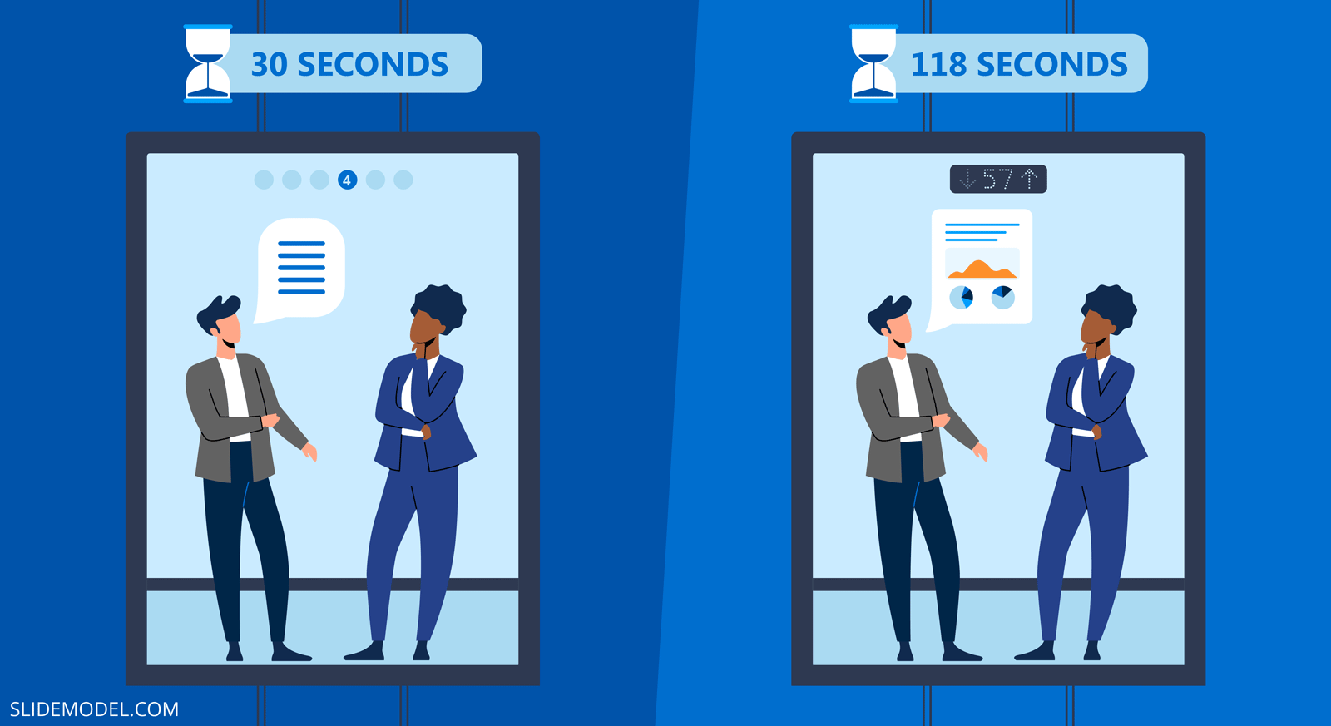
Elevator Pitch… for Peer Learning Activity.
https://slidemodel.com/elevator-pitch-presentations-guide/
Discuss with your teams the project idea.
Come up with brief summaries that you can present in 30 seconds – 3 minutes!

Slide 3

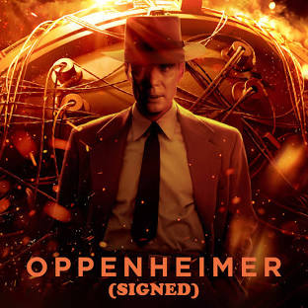
A sample enterprise application
Front-End
Middleware
(Enterprise Service Bus)
Backend Server
Database

Slide 4
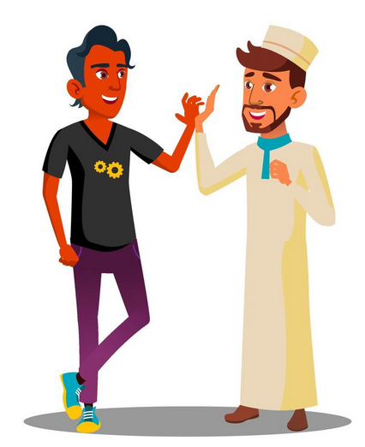
A sample enterprise application
Enter your Zip Code:
Front-End
Middleware
(Enterprise Service Bus)
Backend Server
Database
Image src: https://www.vecteezy.com/vector-art/17384974-two-teenagers-giving-five-to-each-other-arab-indian-guy-vector-isolated-illustration

Slide 5
A sample enterprise application
Enter your Zip Code: 99508
Front-End
Middleware
(Enterprise Service Bus)
Backend Server
Database
Image src: https://www.vecteezy.com/vector-art/17384974-two-teenagers-giving-five-to-each-other-arab-indian-guy-vector-isolated-illustration

Slide 6

A sample enterprise application
Enter your Zip Code: 2343232323
Front-End
Middleware
(Enterprise Service Bus)
Backend Server
Database
Image src https://www.shutterstock.com/image-photo/portrait-indian-bearded-man-wearing-shirt-2034355925

Slide 7
A sample enterprise application
Enter your Zip Code:
0
Front-End
Middleware
(Enterprise Service Bus)
Backend Server
Database
Image src https://www.shutterstock.com/image-photo/portrait-indian-bearded-man-wearing-shirt-2034355925

Slide 8
A sample enterprise application
Enter your Zip Code:
-1
Front-End
Middleware
(Enterprise Service Bus)
Backend Server
Database
Image src https://www.shutterstock.com/image-photo/portrait-indian-bearded-man-wearing-shirt-2034355925

Slide 9
A sample enterprise application
Enter your Zip Code:
NaN
Front-End
Middleware
(Enterprise Service Bus)
Backend Server
Database
Image src https://www.shutterstock.com/image-photo/portrait-indian-bearded-man-wearing-shirt-2034355925

Slide 10
A sample enterprise application
Enter your Zip Code:
Null
Front-End
Middleware
(Enterprise Service Bus)
Backend Server
Database
Image src https://www.shutterstock.com/image-photo/portrait-indian-bearded-man-wearing-shirt-2034355925

Slide 11
A sample enterprise application
Enter your Zip Code:
null
Front-End
Middleware
(Enterprise Service Bus)
Backend Server
Database
Image src https://www.shutterstock.com/image-photo/portrait-indian-bearded-man-wearing-shirt-2034355925

Slide 12
A sample enterprise application
Enter your Zip Code: 93.340
Front-End
Middleware
(Enterprise Service Bus)
Backend Server
Database
Image src https://www.shutterstock.com/image-photo/portrait-indian-bearded-man-wearing-shirt-2034355925

Slide 13
A sample enterprise application
Enter your Zip Code: 99508-9999
Front-End
Middleware
(Enterprise Service Bus)
Backend Server
Database
Image src https://www.shutterstock.com/image-photo/portrait-indian-bearded-man-wearing-shirt-2034355925

Slide 14
A sample enterprise application
Enter your Zip Code: Wednesday
Front-End
Middleware
(Enterprise Service Bus)
Backend Server
Database
Image src https://www.shutterstock.com/image-photo/portrait-indian-bearded-man-wearing-shirt-2034355925

Slide 15
A sample enterprise application
Enter your Zip Code: 99508 OR state = ‘AK’
Front-End
Middleware
(Enterprise Service Bus)
Backend Server
Database
Image src https://www.shutterstock.com/image-photo/portrait-indian-bearded-man-wearing-shirt-2034355925

Slide 16
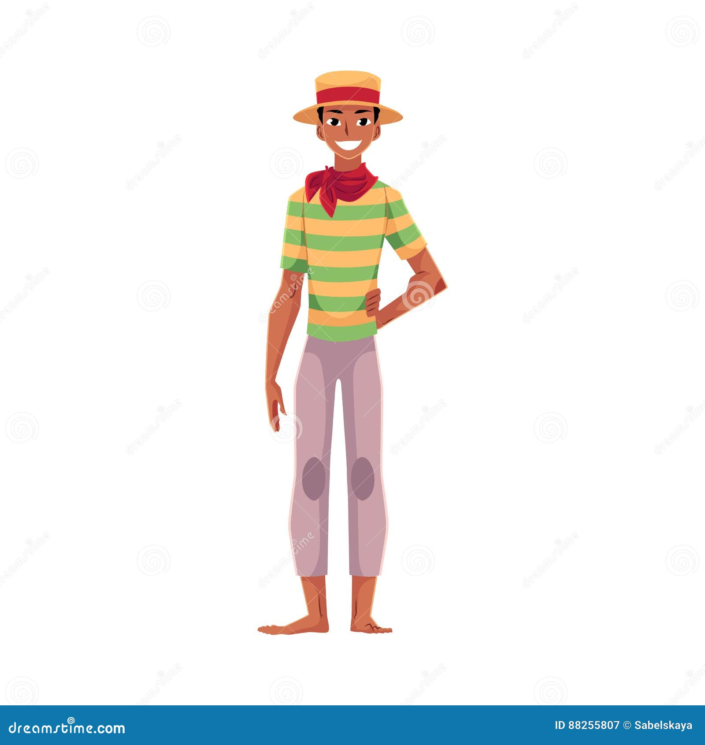
Example
Imagine a small café that authorizes below queries from their website:
Full menu: Food item and its price
Total bill excluding tips for the day so far:
What did the popular Vegetarian Influencer Pedro eat today in this restaurant?
Dish | Price
Chicken Curry | 20
Beef burger | 10
Fried Chicken | 10
Vegan Pizza | 17
Vegetarian Dosa | 12
Turkey Sandwich | 10
Total Bill today so far (excl. Tips) | 57
Image src: https://www.dreamstime.com/stock-illustration-brazilian-man-straw-hat-traditional-festa-junina-party-costume-wearing-red-neck-tie-cartoon-vector-illustration-image88255807

Slide 17
Example
Imagine a small café that authorizes below queries from their website:
Full menu: Food item and its price
Total bill excluding tips for the day so far:
What did the popular Vegetarian Influencer Pedro eat today in this restaurant?
Dish | Price
Chicken Curry | 20
Beef burger | 10
Fried Chicken | 10
Vegan Pizza | 17
Vegetarian Dosa | 12
Turkey Sandwich | 10
Total Bill today so far (excl. Tips) | 50

Slide 18
Thank you
Questions?
pkathiravelu@alaska.edu

